Slide 1
Flame Temperature vs Equivalence Ratio
From eq. ratio 0.5 to 1(lean mixture) flame temp. is increasing for all fuel.
But from 1 to 1.5(rich mixture) flame temp. is decreasing for all fuel.
At eq. ratio of 1(stoichiometry) we are getting maximum flame temp.
Pure Jet-A fuel is giving maximum flame temp. at stoichiometry.
From eq. ratio 0.5 to 1 (lean mixture) flame temp. is increasing for all fuel.
But from 1 to 1.5 (rich mixture) flame temp. is decreasing for all fuel.
At eq. ratio of 1(stoichiometry) we are getting maximum flame temp.
Jet-A + 20% methanol combination is giving maximum flame temp. at stoichiometry.

Slide 2
CO₂ Mole fraction vs Equivalence ratio
From eq. ratio 0.5 to 1 CO2 Mole fraction is increasing for all fuel.
But from eq. ratio of 1 to 1.25 CO₂ Mole fraction is decreasing for all fuel.
At eq. ratio of 1(stoichiometry) we are getting maximum CO₂ Mole fraction.
Pure Jet-A fuel is giving maximum CO2 Mole fraction
At eq. ratio of 1.25 CO2 mole fraction is approximately same.
From eq. ratio 0.5 to 1 CO2 Mole fraction is increasing for all fuel.
But from 1 to 1.5 CO₂ Mole fraction is decreasing drastically for all fuel.
At eq. ratio of 1(stoichiometry) we are getting maximum CO₂ Mole fraction.
Jet-A + 20% ethanol fuel is giving maximum CO2 Mole fraction.

Slide 3
CO Mole fraction vs Equivalence Ratio
From eq. ratio 0.75 to 1 CO Mole fraction is increasing in small quantity for all fuel.
But from 1 to 1.5 (Rich mixture) CO Mole fraction is increasing drastically for all fuel.
Pure Jet-A fuel is giving maximum CO Mole fraction (CO to have after combustion is not advisable because its harmful hence not desirable)
From eq. ratio 0.75 to 1 CO Mole fraction is increasing in small quantity for all fuel.
But from 1 to 1.5 (Rich mixture) CO Mole fraction is increasing drastically for all fuel.
Pure Jet-A + 50% methanol fuel is giving maximum CO Mole fraction (CO to have after combustion is not advisable because its harmful hence not desirable)

Slide 4
NO Mole fraction vs Equivalence Ratio
From eq. ratio 0.5 to 0.75 (very lean mixture) NO Mole fraction is increasing for all fuel.
But from 0.75 to 1 (lean mixture) NO Mole fraction is decreasing for all fuel.
From 1 to 1.25 (Rich mixture) NO mole fraction decreasing drastically
From 1.25 to 1.5 NO mole fraction slope is very small.
Pure Jet-A fuel is giving maximum NO Mole fraction at 0.75 Eq. ratio (NO to have after combustion is not advisable because its harmful hence not desirable)
From eq. ratio 0.5 to 0.75 (very lean mixture) NO Mole fraction is increasing drastically (slope is very high) for all fuel.
But from 0.75 to 1 (lean mixture) NO Mole fraction is decreasing for all fuel.
From 1 to 1.25 NO mole fraction decreasing drastically.
From 1.25 to 1.5 NO mole fraction slope is very small.
Pure Jet-A + 20% ethanol fuel is giving maximum NO Mole fraction at 0.75 Eq. ratio (NO to have after combustion is not advisable because its harmful hence not desirable)

Slide 5
Increasing in pressure results in increasing the flame temp. but not as significant.
For Jet-A fuel we are getting highest flame Temp.
Increasing in pressure results in increasing the CO2 mole fraction but not as significant.
For Jet-A fuel we are getting highest CO2 mole fraction
Increasing in pressure results in decreasing the CO Mole fraction
but not as significant.
For Jet-A fuel we are getting highest CO Mole fraction.
Increasing in pressure results in increasing the NO Mole Fraction
but not as significant.
For Jet-A fuel we are getting highest NO Mole Fraction.

Slide 6
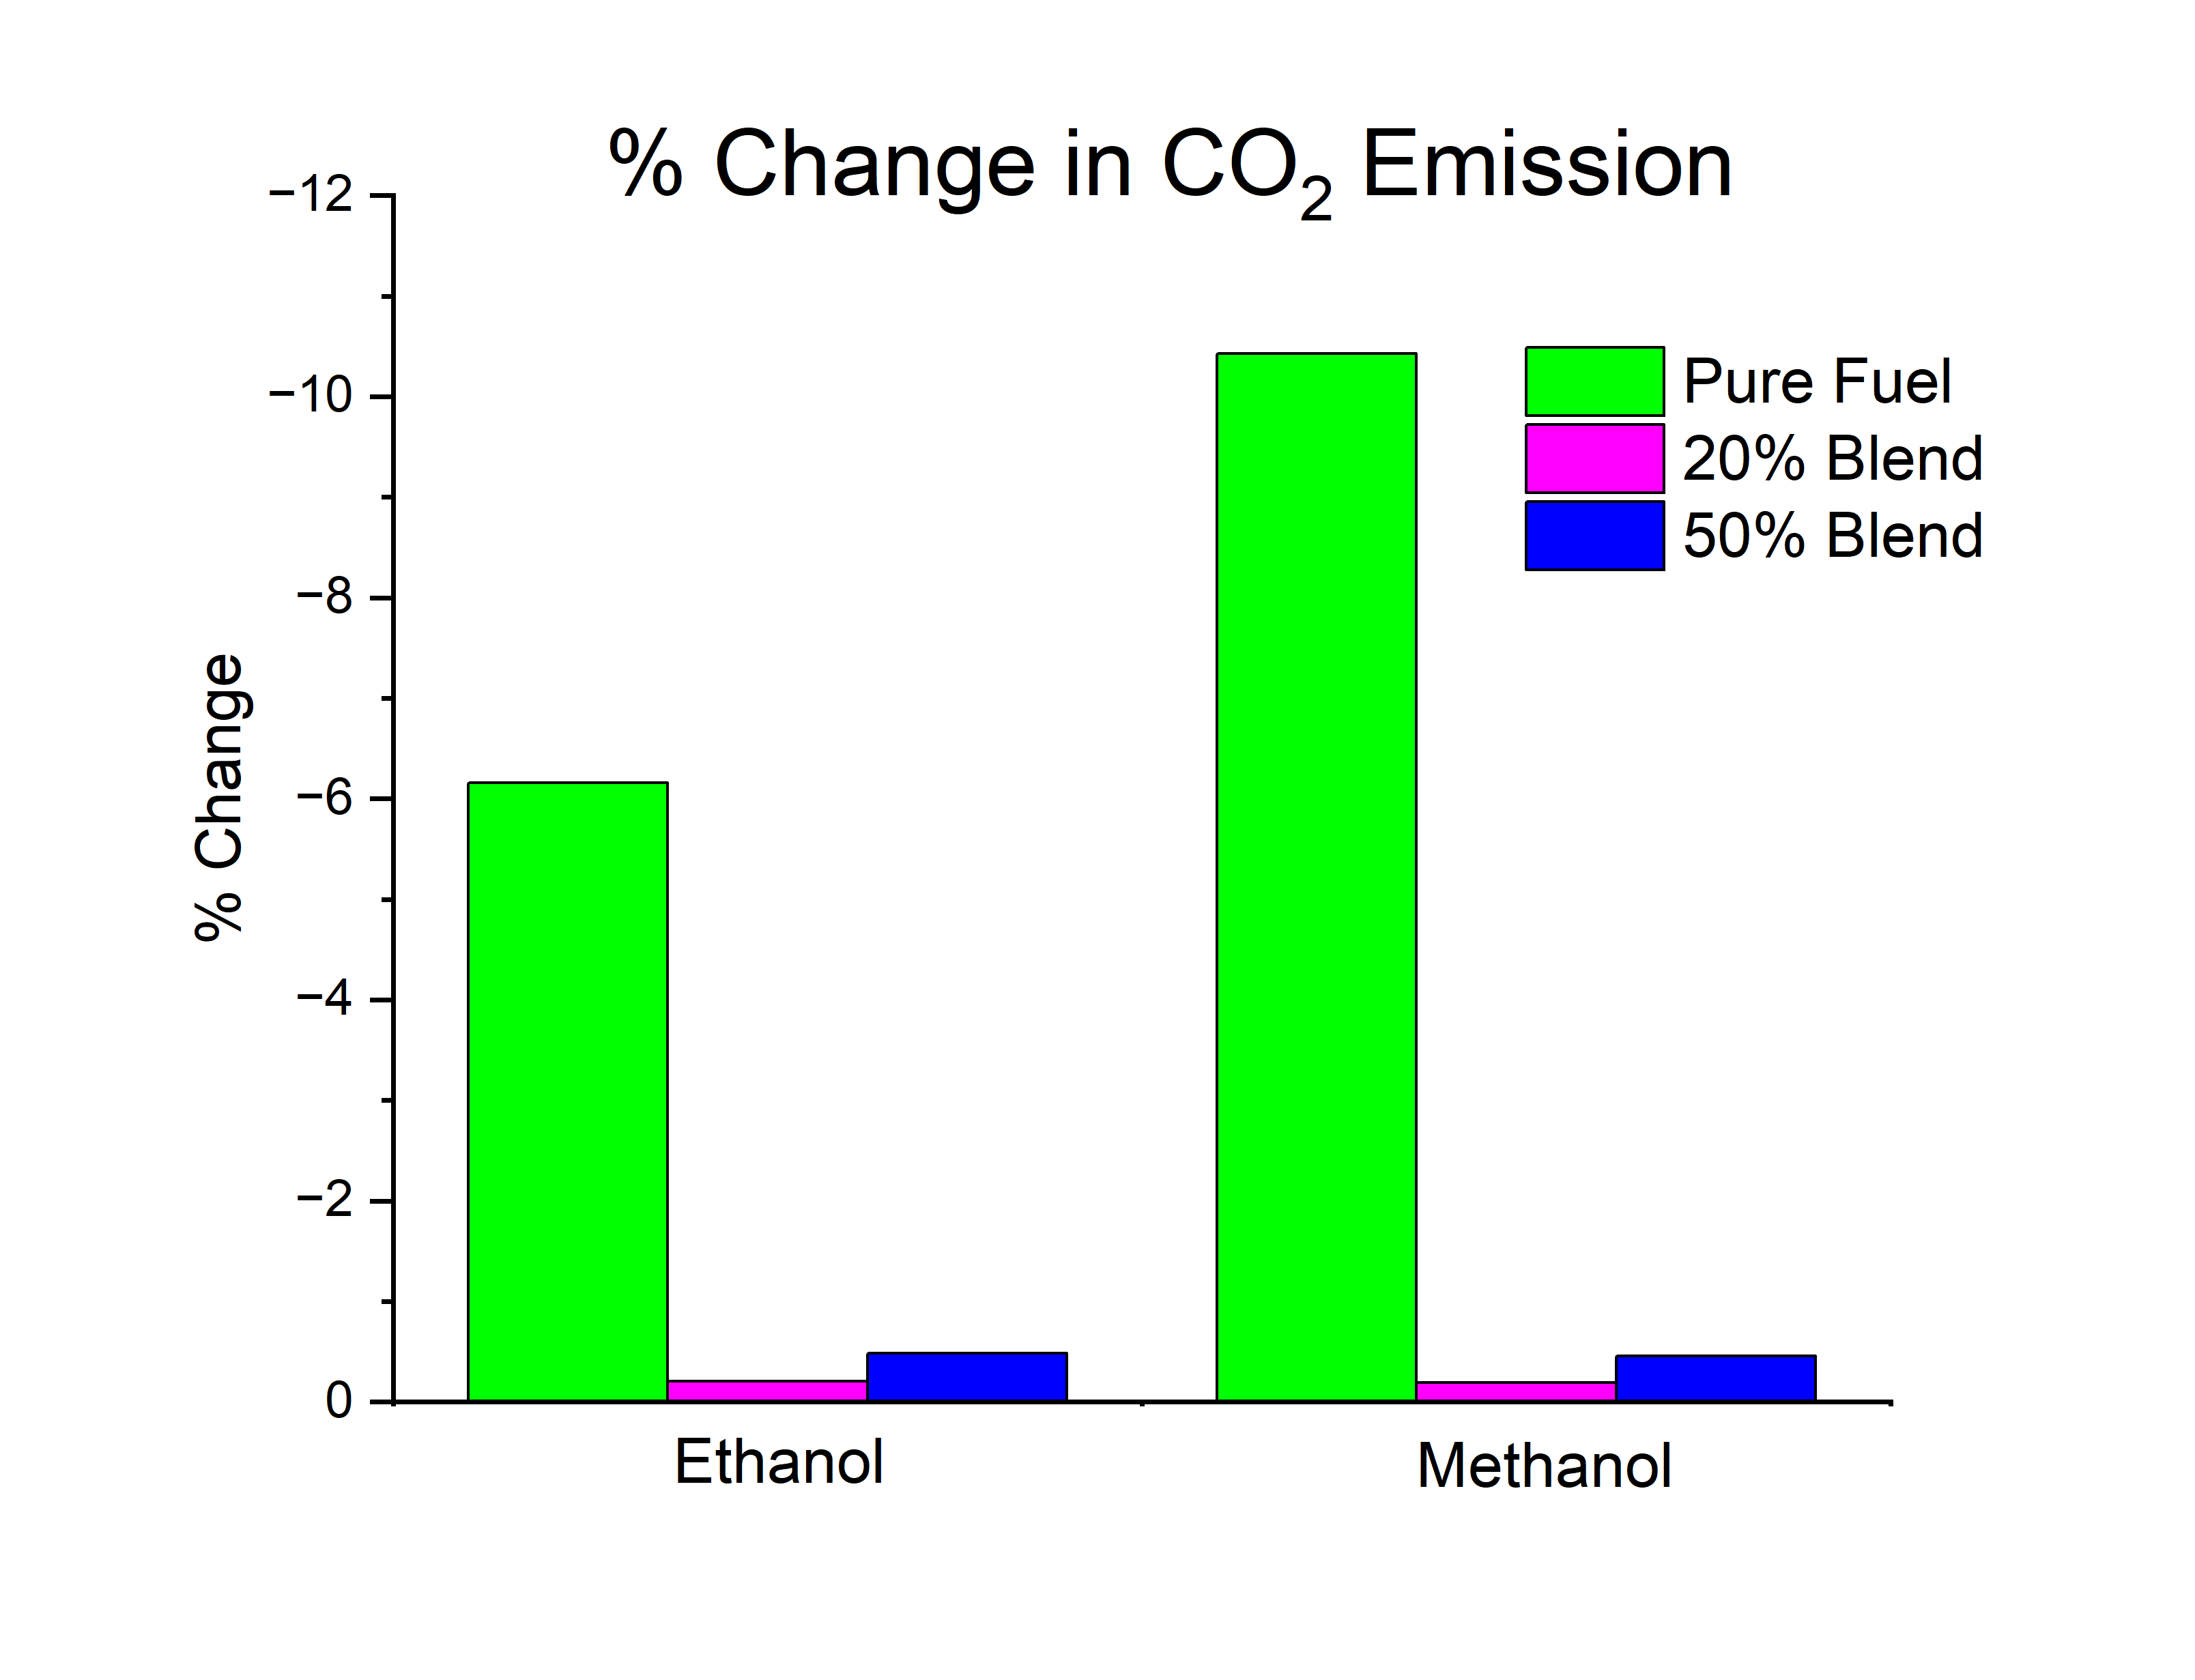
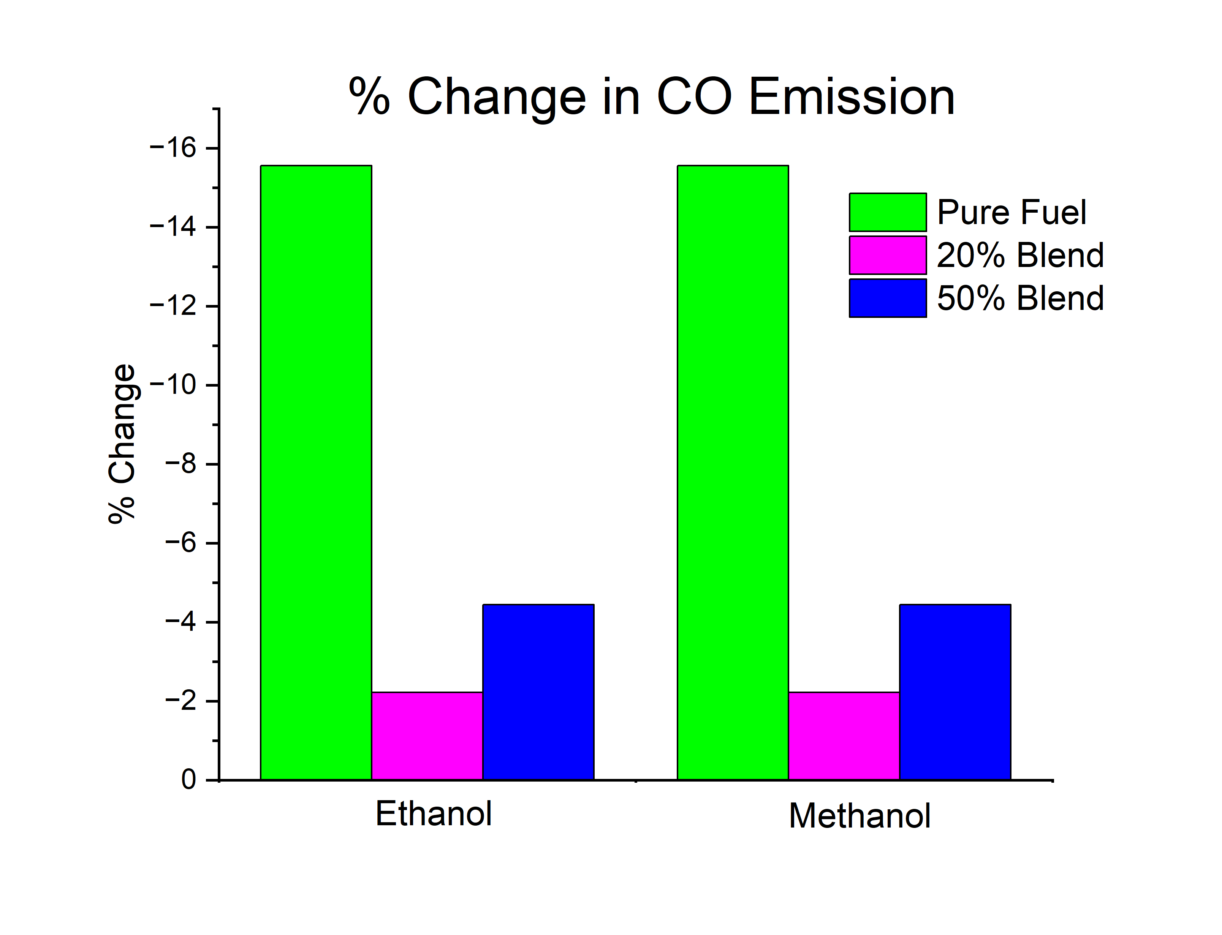
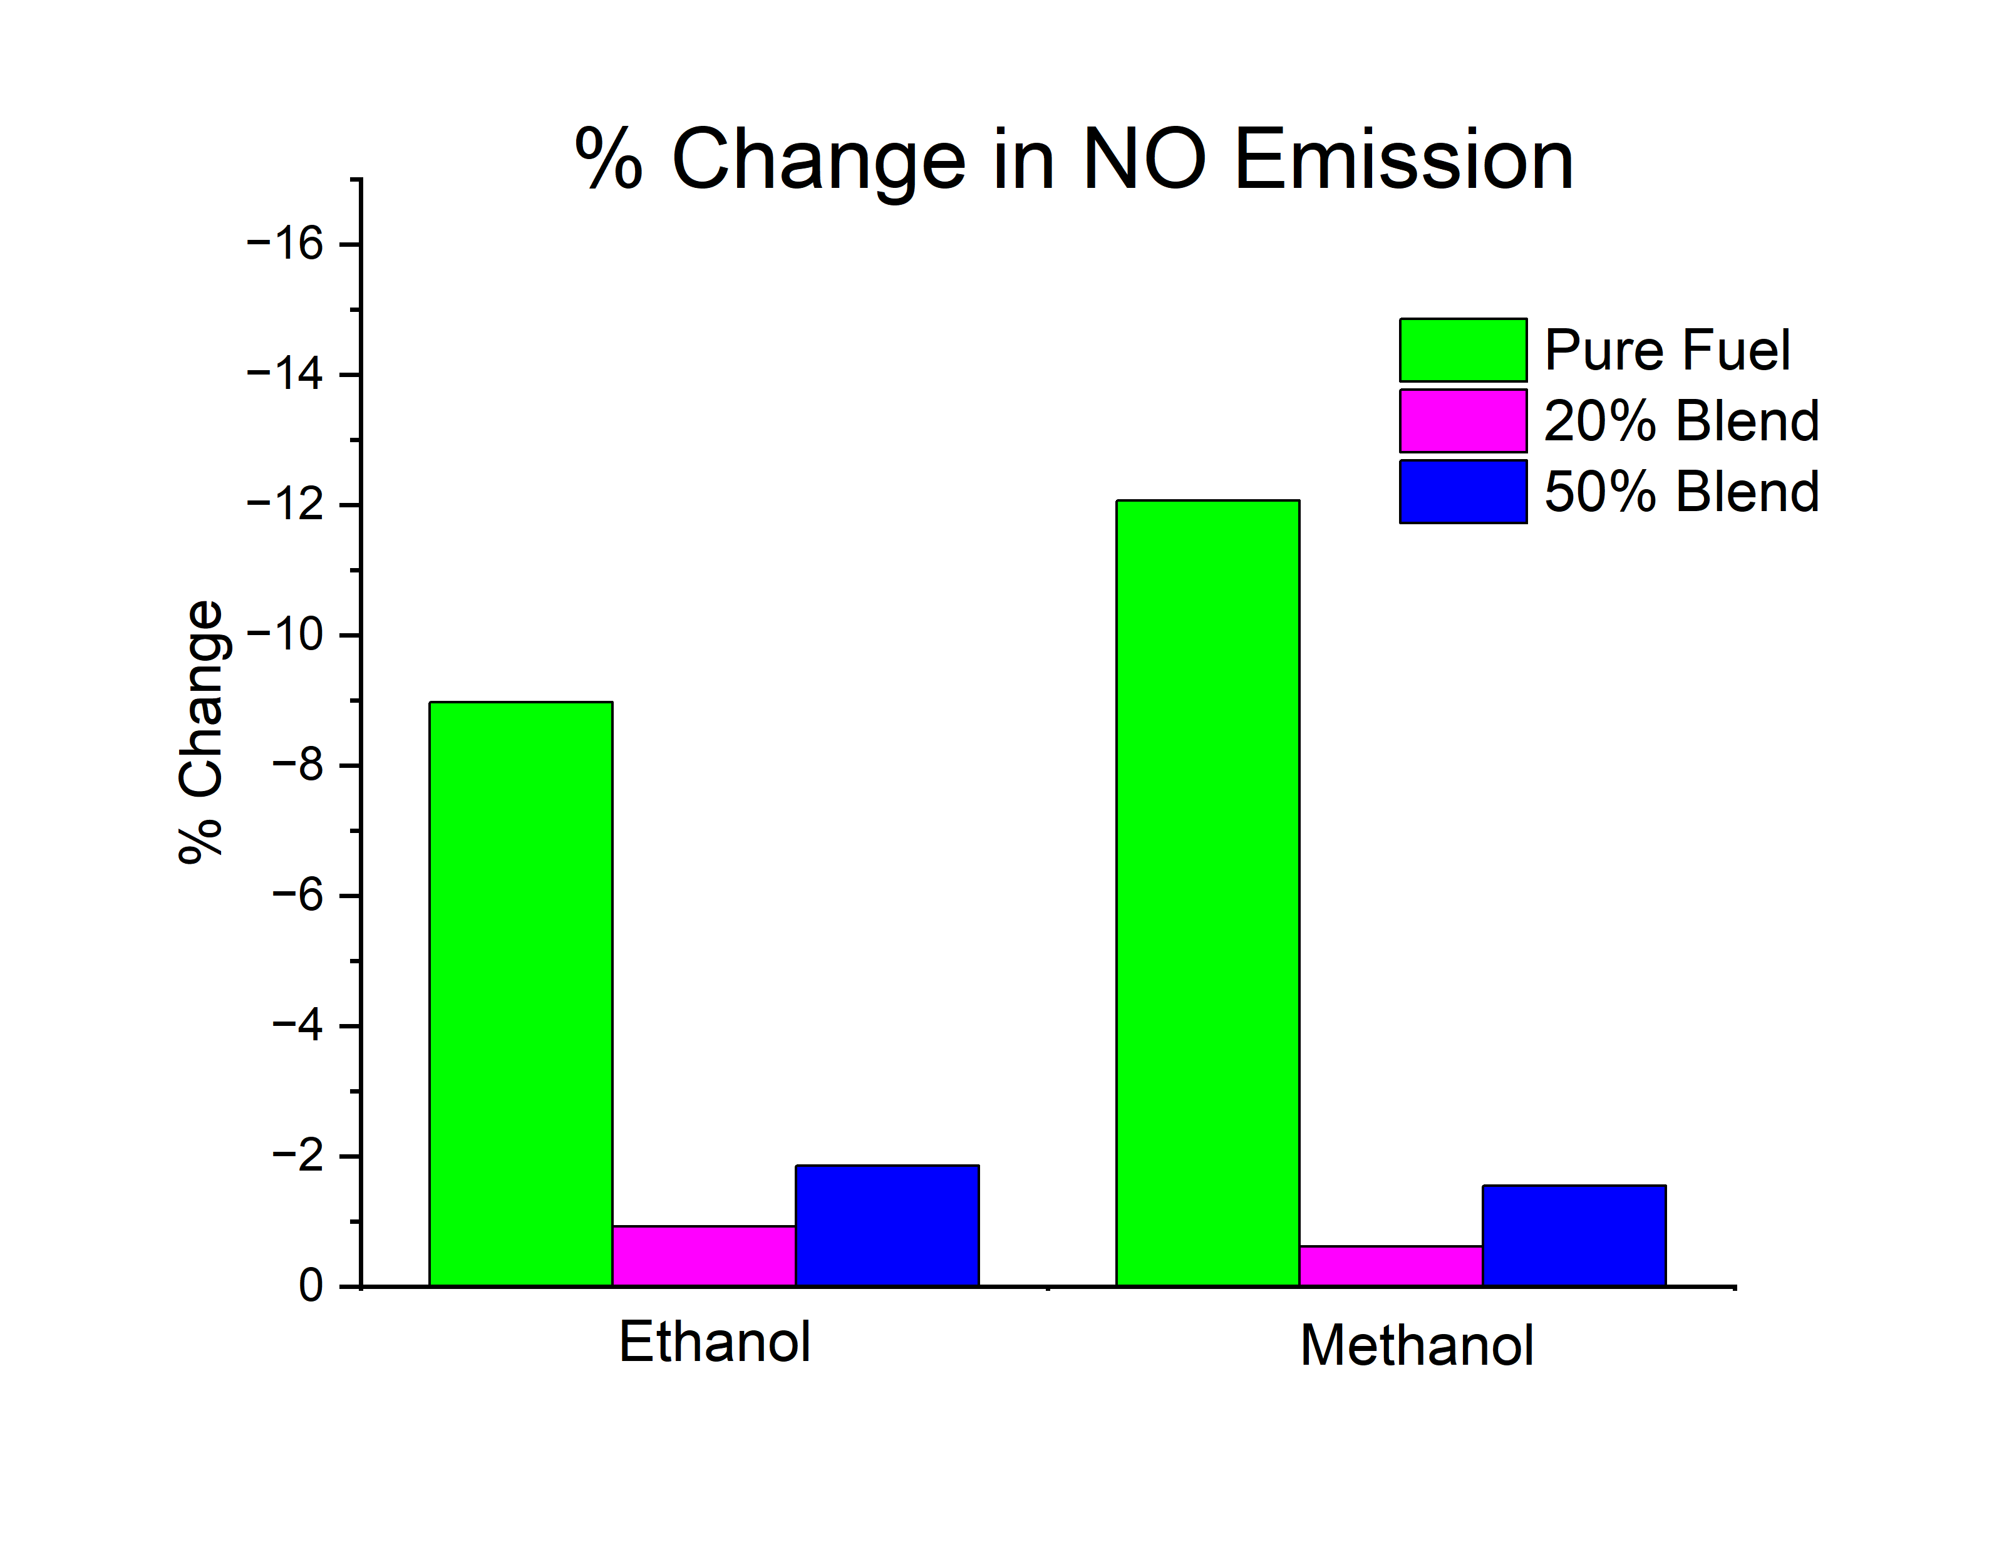
% Change in various emissions with respect to Jet A for Pure Ethanol, Pure Methanol and their 20% & 50% blend with Jet A

Slide 7
Comparison between Jet-A + 20%ethanol vs Pure Jet - A

Slide 8
Comparison between Jet-A + 50%ethanol vs Pure Jet - A

Slide 9
Comparison between Jet-A + 20% methanol vs Pure Jet - A

Slide 10
Comparison between Jet-A + 50% methanol vs Pure Jet - A

